Slide 1
HOME (als doorlopende pagina uit 3 delen)

Slide 2
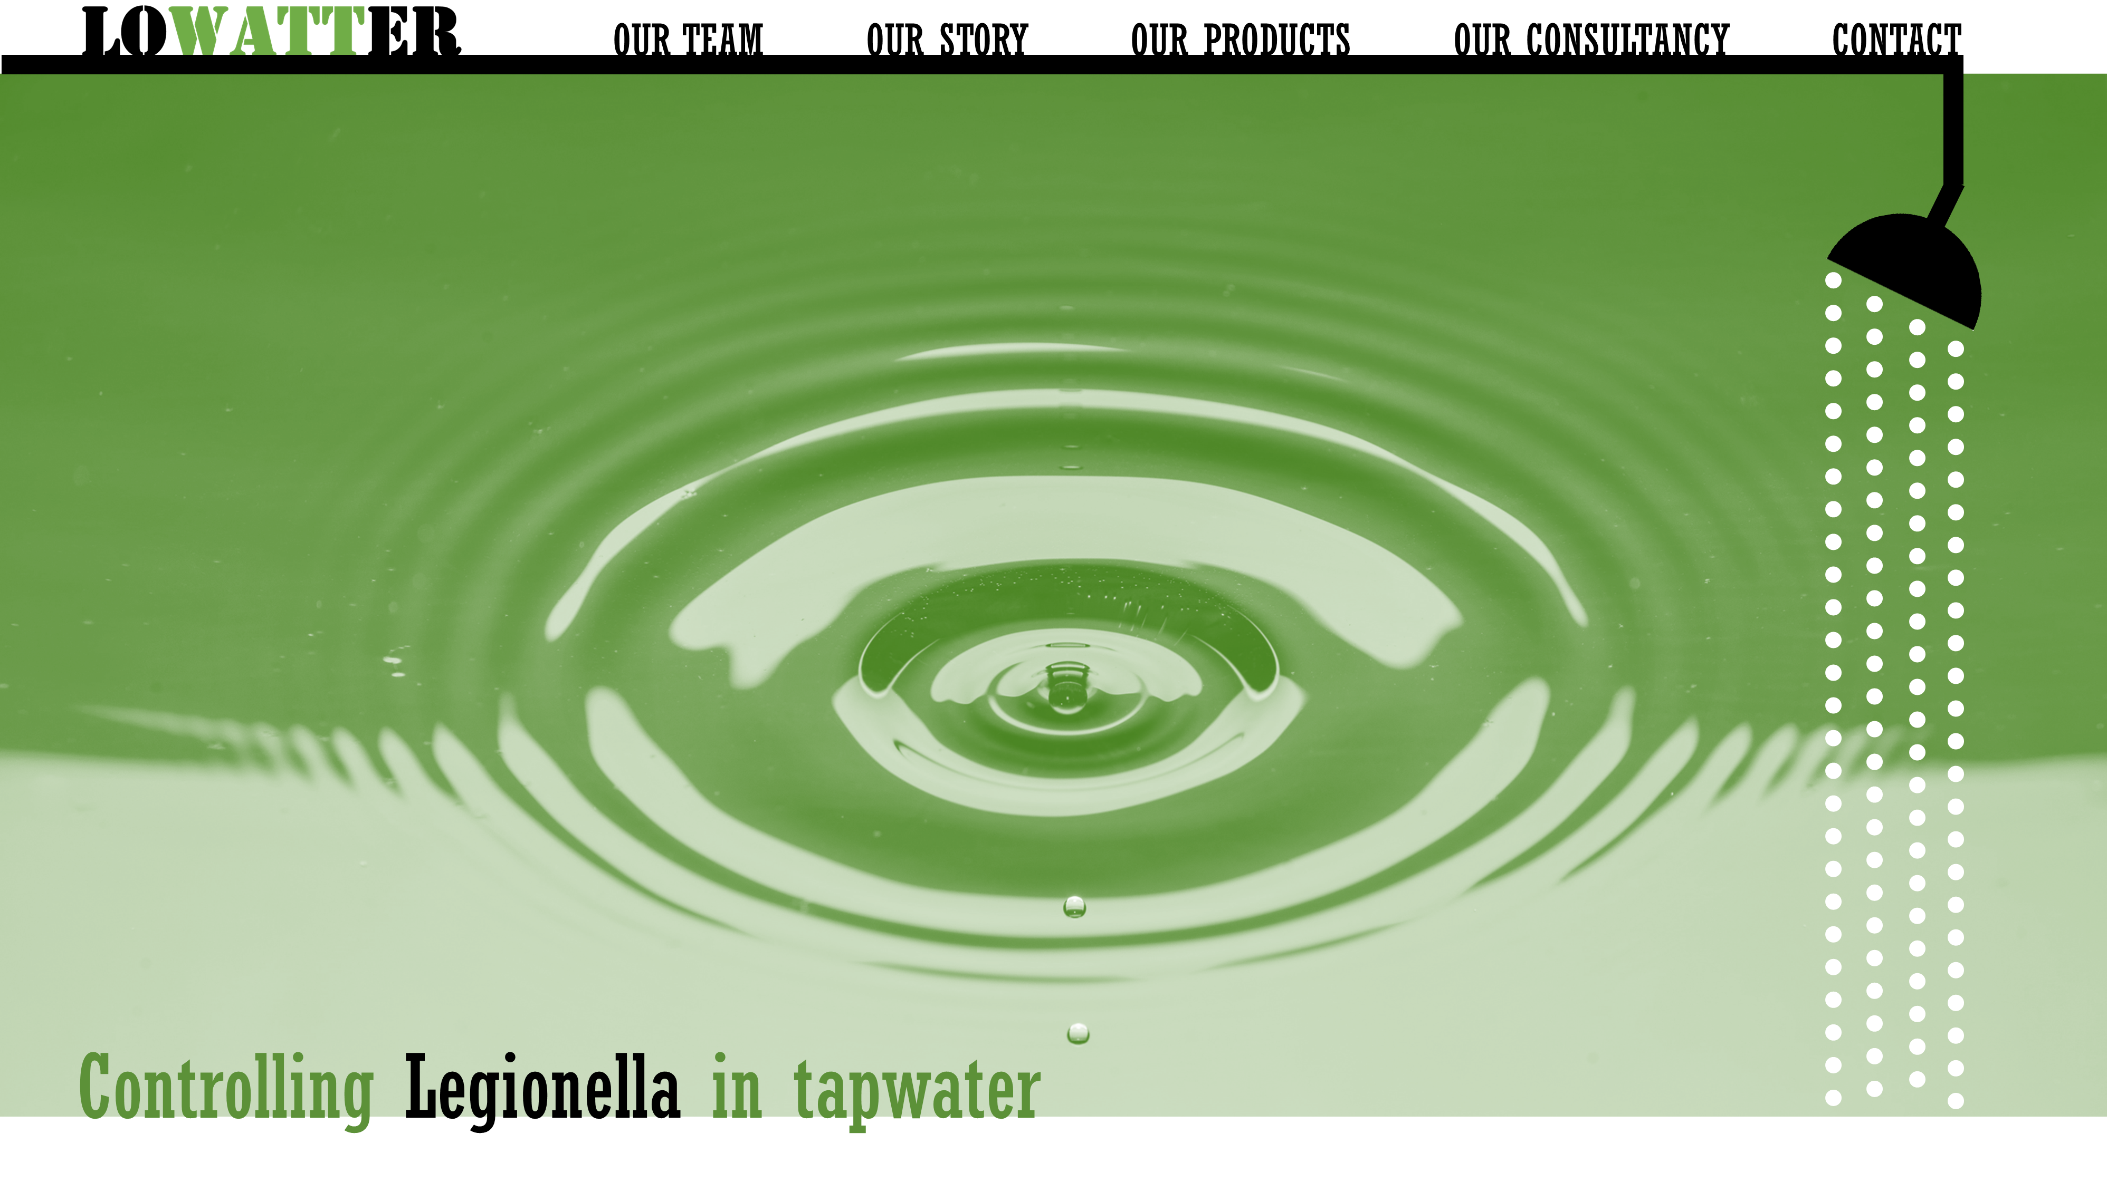
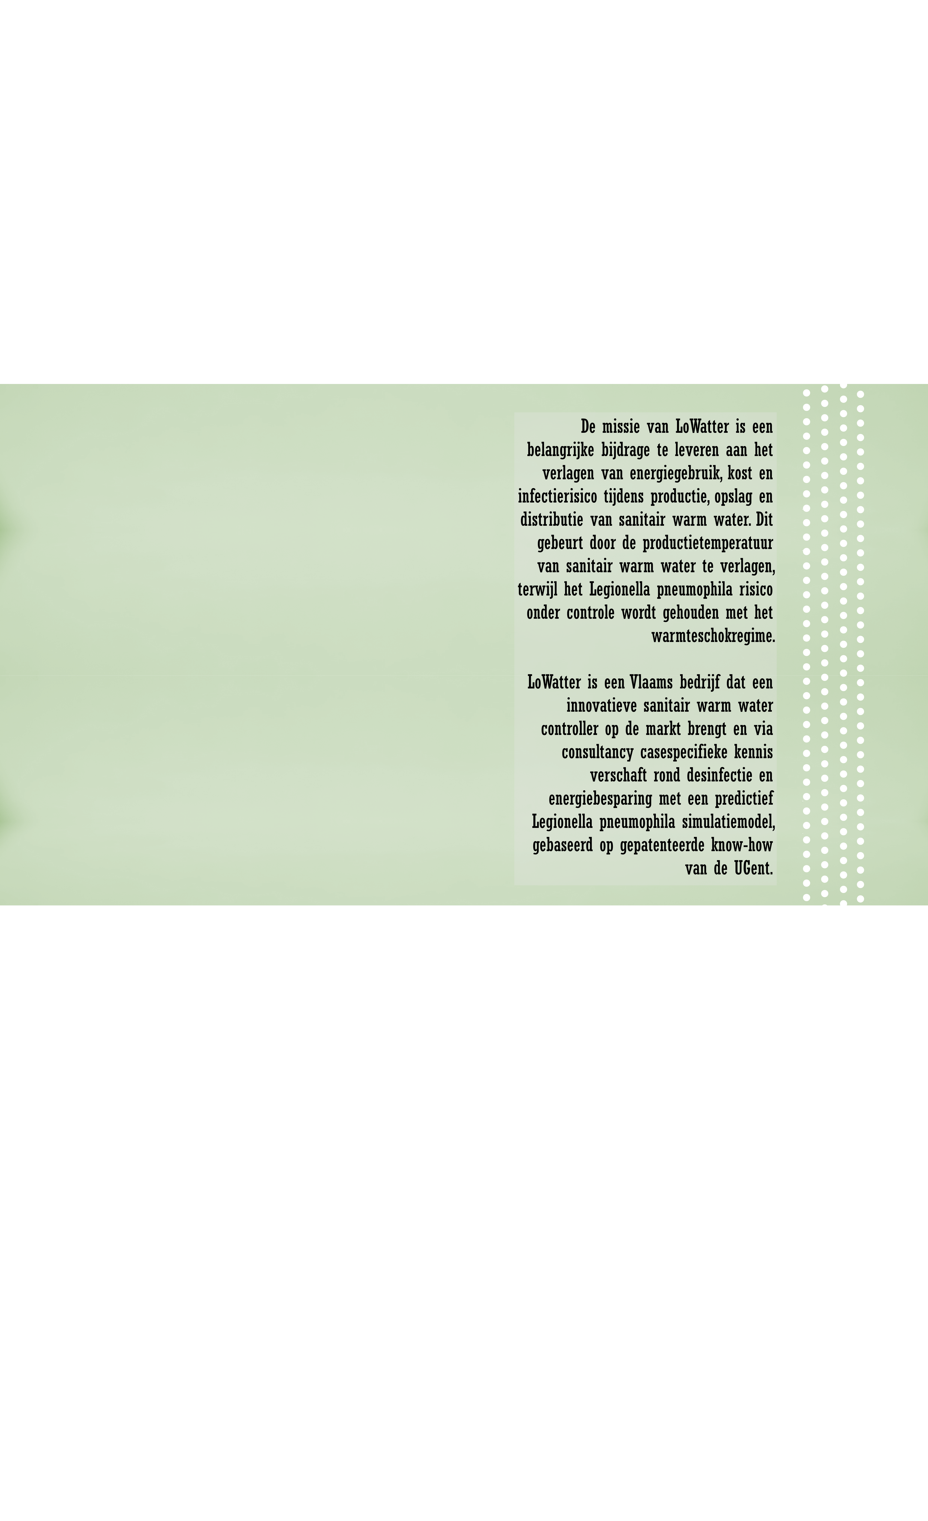
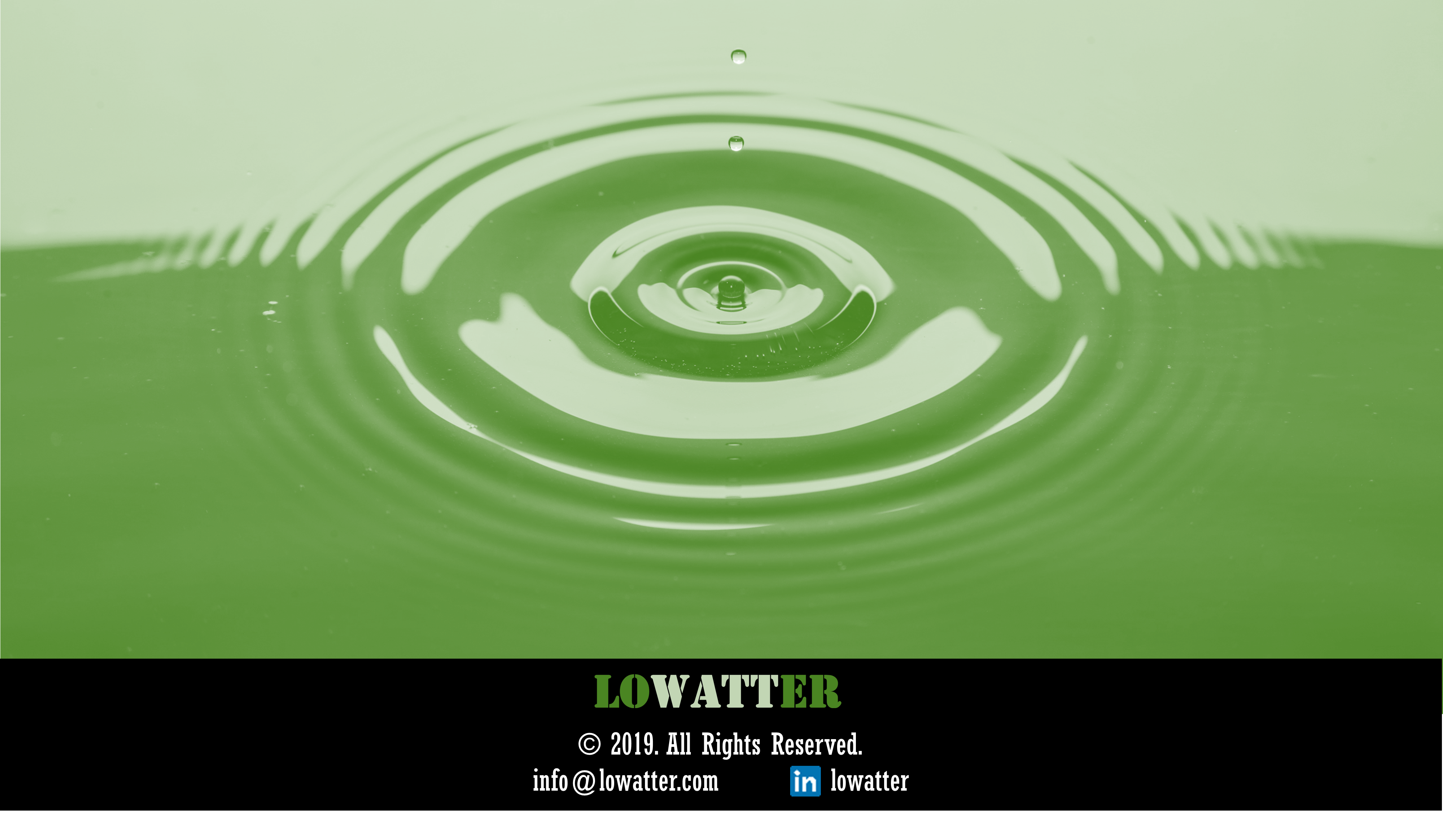

Slide 3
HOME (deel 1)

Slide 4



OUR TEAM OUR STORY OUR PRODUCTS OUR CONSULTANCY CONTACT
Controlling Legionella in tapwater

Slide 5
HOME (deel 2 in Nederlands)

Slide 6
De missie van LoWatter is een belangrijke bijdrage te leveren aan het verlagen van energiegebruik, kost en infectierisico tijdens productie, opslag en distributie van sanitair warm water. Dit gebeurt door de productietemperatuur van sanitair warm water te verlagen, terwijl het Legionella pneumophila risico onder controle wordt gehouden met het warmteschokregime.
LoWatter is een Vlaams bedrijf dat een innovatieve sanitair warm water controller op de markt brengt en via consultancy casespecifieke kennis verschaft rond desinfectie en energiebesparing met een predictief Legionella pneumophila simulatiemodel, gebaseerd op gepatenteerde know-how van de UGent.

Slide 7
HOME (deel 2 tekst Engels)

Slide 8
The mission of LoWatter is to make a significant contribution to lower the energy use, cost and infection risk during production, storage and distribution of domestic hot water. This is possible by lowering the domestic hot water production temperature, while keeping the Legionella pneumophila risk under control with the heat shock regime.
LoWatter is a Flemish company that markets an innovative domestic hot water heating controller and provides case specific knowledge through consultancy on either disinfection or energy savings with a Legionella pneumophila predicting simulation model, based on UGent proprietary know-how.

Slide 9
HOME (deel 3 + footer)

Slide 10

© 2019. All Rights Reserved.
info@lowatter.com lowatter

Slide 11
OUR TEAM (deel 1)

Slide 12



OUR TEAM OUR STORY OUR PRODUCTS OUR CONSULTANCY CONTACT
Notes:
Doorklikken op persoon mogelijk maken, dan tekstje met biografie

Slide 13
OUR TEAM (deel 2)

Slide 14

© 2019. All Rights Reserved.
info@lowatter.com lowatter

Slide 15
OUR STORY

Slide 16
NL | ENG
OUR TEAM OUR STORY OUR PRODUCTS OUR CONSULTANCY CONTACT
Placeholder.
Placeholder.
12/2018
Placeholder.
Placeholder.
12/2018
Placeholder.
Placeholder.
12/2018
Notes:
Doorklikken naar kleinere blogs

Slide 17
OUR PRODUCTS

Slide 18
NL | ENG
OUR TEAM OUR STORY OUR PRODUCTS OUR CONSULTANCY CONTACT
With the innovative domestic hot water controller you can lower the energy use, cost and infection risk during production, storage and distribution of your domestic hot water. This is possible by lowering the domestic hot water production temperature, while keeping the Legionella pneumophila risk under control with the heat shock regime.
More information is coming soon!

Slide 19
OUR CONSULTANCY

Slide 20
NL | ENG
OUR TEAM OUR STORY OUR PRODUCTS OUR CONSULTANCY CONTACT
LoWatter provides case specific knowledge through consultancy on either disinfection or energy savings with a Legionella pneumophila predicting simulation model in order to lower the energy use, cost and infection risk during production, storage and distribution of domestic hot water.
More information is coming soon!

Slide 21
CONTACT

Slide 22
OUR TEAM OUR STORY OUR PRODUCTS OUR CONSULTANCY CONTACT
Let’s connect
First name*
Enter your first name
Last name*
Enter your last name
Company
Enter your company name
Email*
Enter your email address
Phone
Enter your phone number
Subject
Enter subject
Message
Enter your message
Fields with * are required
SEND
info@lowatter.com Sint-Pietersnieuwstraat 41 B4
9000 Ghent, Belgium
© 2019. All Rights Reserved.
info@lowatter.com lowatter

